Slide 1
WoT and NGSI-LD NGSI-LD Introduction
Presented by: Franck Le Gall (Chair ETSI ISG CIM) Martin Bauer (Vice-Chair ETSI ISG CIM)
For: W3C Web of Things
29/11/2025

Slide 2
NGSI-LD – Evolution and specification in ETSI ISG CIM
European Telecommunications Standards Institute (ETSI)
ETSI produces globally-applicable standards for Information and Communications Technologies (ICT)
It is officially recognized by the European Commission as a European Standards Organization
Industry Specification Groups (ISG) allow participation of non-ETSI-members
ETSI ISG for cross-cutting Context Information Management (ETSI ISG CIM)
Established in 2017 – extended until 2025 (requesting extension until 2027, possible move to TC Data)
Currently about 30 supporting organizations
Evolution of NGSI Context Interfaces →NGSI-LD
https://www.etsi.org/deliver/etsi_gs/CIM/001_099/009/01.08.01_60/gs_CIM009v010801p.pdf
2010 OMA NGSI
2012-2016: NGSI v1/v2
2019: NGSI-LD
Context API in Open Mobile Alliance (OMA)
FIWARE project develops binding and evolves OMA NGSI standard
Evolution as ETSI ISG CIM specification based on JSON-LD

Slide 3
High-Level Design Goals of NGSI-LD
Evolution of OMA/FIWARE NGSI Context Interfaces
Put NGSI-LD Information Model on a solid conceptual grounding
Property graph model
Enable semantic concept definitions
Enable linking to existing information
Enable applications to specify WHAT information they require (based on the NGSI-LD Information Model) – including geographic scoping and temporal interface
Support central as well as distributed and federated NGSI-LD system architectures with arbitrary information distribution
Linked Data

Slide 4
Background: Why “Context” and “Context Interfaces”?
History: What is Context?
Anind Dey‘s definition (2001) of context as “any information that can be used to characterize the situation of an entity.”
The world consists of entities.
Entities can be identified and have properties.
What are Context Interfaces? (OMA)
I am looking for a specific entity (→ id) and its properties
I am looking for a kind of entity (→ type) in my environment/area of interest (and its properties)
I am interested in a change of state related to a property / entity

Slide 5
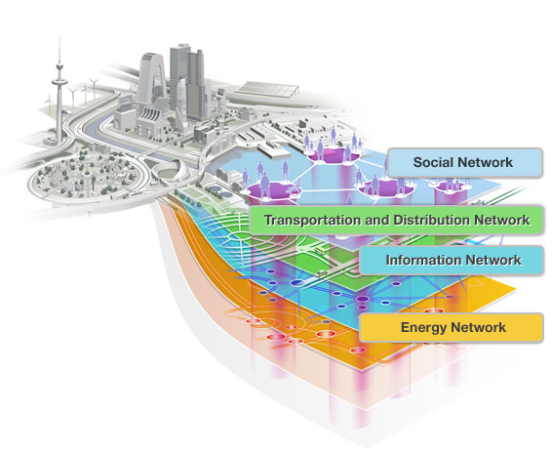


NGSI-LD Information Model (Property Graph)
Entity (type, identifier)
Advantages of NGSI-LD Entity Graph
= knowledge graph
~ index structure, follow relationships to find relevant entities
retrieve relevant subset of entities and use advanced graph tools
Property
NGSI-LD Information Model (Property Graph)
location
Attribute
isAttached
Relationship
location,
speed
speed
livesAt
location
address
owns
link to 3D model
link to video
<situation id="GU ID2A22530C-D4 52-4ae8-B942-9 93BC2923D13" v ersion="1">
<overallSeverity> high< /overallSeverity>
a foaf:Person ; foaf:name "Jimmy Wales" ; foaf:mbox <mailto:jwales@bomis.com> ; foaf:homepage <http://www.jimmywales.com>
"contextRegistration": [
{ "entities": [ { "id": "E1",
"type": "T1",
“ isPattern": "false" },
{ "id": "E2",
"type": "T2", “
isPattern": "false" } ],
Data Lake with silos of heterogeneous data
asNDAGAINqwq Ajksajasdfahdsjfk ASD2348FNA;W Asdafnasd;fmasd ASwt5iqwerjsfg43
<buildingA> <room5>
<occupancy>1
10</...>
All clipart is under Creative Commons BY 4.0 Licence from https://www.svgrepo.com

Slide 6
NGSI-LD-compatible Data Model
Entity (type, identifier)
Property
What entity types are there?
NGSI-LD-compatible Data Models
location
Relationship
isAttached
What properties can instances of a certain
entity type have?
location,
speed
speed
livesAt
location
address
What relationships can instances of a certain
entity type have?
owns
link to 3D model
link to video
→ Data Models
<situation id="GU ID2A22530C-D4 52-4ae8-B942-9 93BC2923D13" v ersion="1">
<overallSeverity> high< /overallSeverity>
a foaf:Person ; foaf:name "Jimmy Wales" ; foaf:mbox <mailto:jwales@bomis.com> ; foaf:homepage <http://www.jimmywales.com>
"contextRegistration": [
{ "entities": [ { "id": "E1",
"type": "T1",
“ isPattern": "false" },
{ "id": "E2",
"type": "T2", “
isPattern": "false" } ],
asNDAGAINqwq Ajksajasdfahdsjfk ASD2348FNA;W Asdafnasd;fmasd ASwt5iqwerjsfg43
<buildingA> <room5>
<occupancy>1
10</...>
All clipart is under Creative Commons BY 4.0 Licence from https://www.svgrepo.com

Slide 7
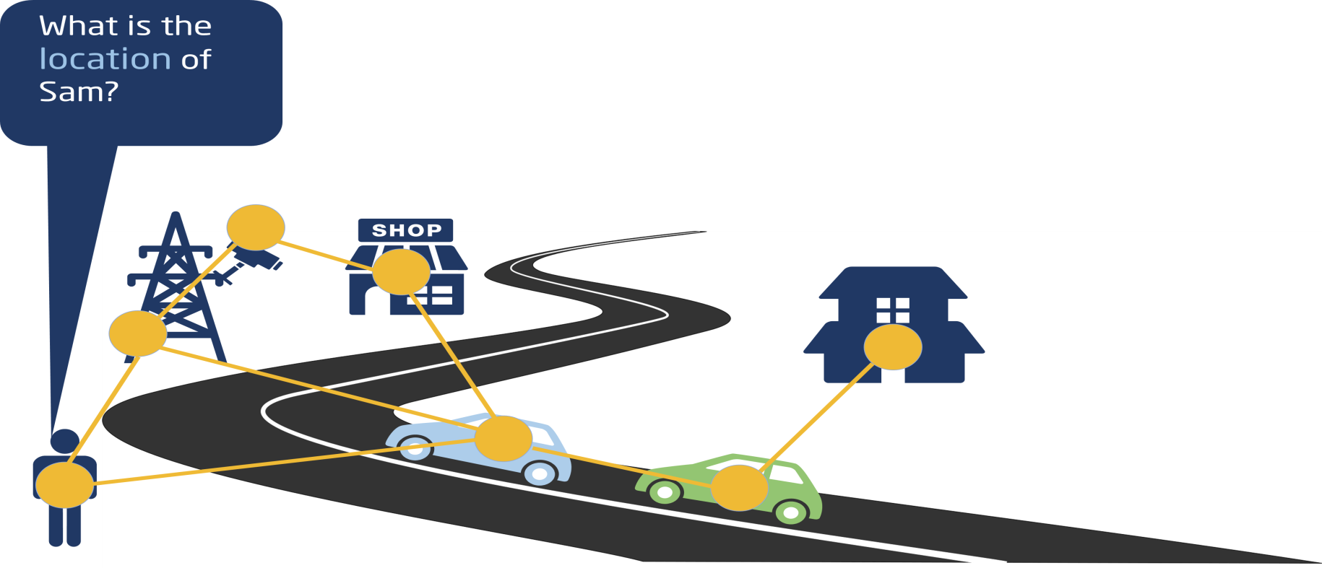
NGSI-LD API – Example: Retrieve Specific Entity
What do applications need to know:
Base URL: http://localhost:9090/ngsi-ld/v1/entities/
Entity Id: urn:ngsi-ld:Person:Sam
Data Model: location property
Security credentials (orthogonal aspect, not shown on following slides)
No need to know:
Where the information is stored

Slide 8
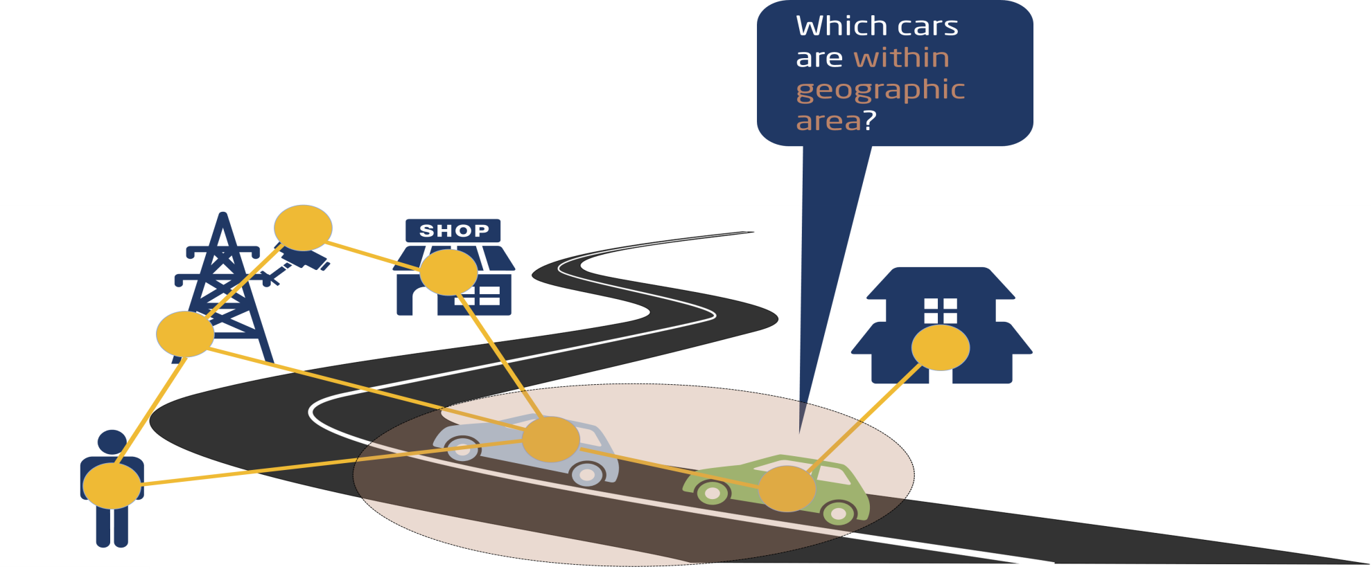
NGSI-LD API – Example: Geographic Query
What do applications need to know:
Base URL: http://localhost:9090/ngsi-ld/v1/entities/
Data Model: car type
Geographic location
No need to know:
Where the information is stored

Slide 9
NGSI-LD API – Example: Subscription / Notification
“Notify me, if any new cars are detected in the specified geographic area“ Two cases to be monitored at the same time:
new car added to the system with location in the area
location of existing car has changed and is now within specified area.

Slide 10
Collaboration with W3C WoT
Scope
NGSI-LD Binding that defines what information is needed in a Thing Description to communicate with an NGSI-LD Context Broker and access specific Things/NGSI-LD Entities.
Extensions of existing specifications to include the use of a WoT Thing Description for NGSI-LD model descriptions

